Slide 1
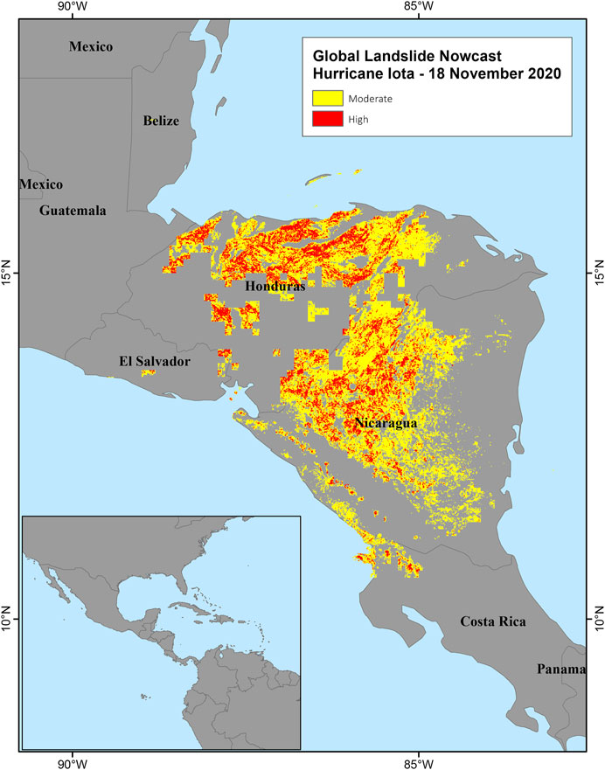
“Land Slide Prediction Using Machine Learning”
presented by
Abdul Wahed
Guided by
Er. Soumya Snigdha Mohapatra
Asst . Professor
Dept . of Computer Science & Engg .

Slide 2
CONTENTS
Introduction
Objective
Literature survey
Data collection
Methodology
Result
Conclusion & future scope
Reference

Slide 3
Introduction
What Is Landslide Prediction ?
A landslide is a natural disaster that occurs when a mass of soil, rock, or debris slides down a slope or cliff. It is a type of mass wasting, which refers to the movement of earth materials under the influence of gravity. Landslides can be triggered by a variety of factors, such as heavy rainfall, earthquake, volcanic eruption, human activities, or changes in the slope's stability.
Landslides can cause significant damage to infrastructure, property, and human life. They can also have long-term impacts on the environment, such as altering the landscape, changing drainage patterns, and creating new habitats for plants and animals. Understanding the causes, triggers, and characteristics of landslides is important for mitigating their impact and reducing the risk of future disasters.
Landslides are a major geologic hazard in the u . s – 25 to 50 fatalities per year
-$1B to $3B property damages

Slide 4
Demerit of landslide prediction & classification using manual method
1. Loss of Lives and Properties Being Destroyed
The mass of the rock or the piece of earth can lead to heavy property destruction and
people getting stuck beneath it can even lead to death.
2. Communication Problems
The mass when falls on roads or other riding lanes can lead to blockage leading to communication problems.
3. River Blockage
The huge land masses can block rivers causing issues, severe issues.
To prevent such things to occur, some preventions are taken. Some preventions include:
4. Retention Wall
Retention wall is a rigid wall that is responsible to support soil preventing land from slipping.

Slide 5
Benefits of predicting thorough the machine learning .
Machine learning and deep learning plays an important role in computer technology and artificial intelligence. With the use of deep learning and machine learning, human effort can be reduced in recognizing, learning, predictions and many more areas.
To make machines more intelligent, the developers are diving into machine learning and deep learning techniques.
A human learns to perform a task by practicing and repeating it again and again so that it memorizes how to perform the tasks.
Prediction in machine learning allows organizations to make predictions about possible outcomes based on historical data.
In landslide forecasting, machine learning methods are being utilized to improve model accuracy and, in particular, the flexibility of such models to handle a wide range of conditioning factors

Slide 6
Objective
1.Early warning:
The main goal of landslide prediction is to provide early warnings of imminent landslides. Early warnings can help people evacuate the affected areas and take preventive measures to minimize the damage caused by landslides.
2.Mitigation of damage:
The second goal of landslide prediction is to minimize the damage caused by landslides. Landslides can cause damage to infrastructure, buildings, and property
3. Risk assessment:
The third goal of landslide prediction is to assess the risks associated with landslides. By analyzing the environmental factors that contribute to landslide occurrence, it is possible to identify areas that are prone to landslides and take preventive measures to reduce the risk of landslides occurring.
4. Resource allocation:
The fourth goal of landslide prediction is to allocate resources efficiently to mitigate the risks associated with landslides. By predicting the occurrence of landslides, local authorities and emergency responders can allocate resources such as manpower, equipment, and supplies to the affected areas more efficiently.

Slide 7
Literature Survey
Landslide prediction is a crucial area of study for mitigating the risks associated with landslides. Various techniques have been developed for predicting landslides, ranging from traditional methods to modern technologies.
Landslides can occur due to heavy rainfall, earthquake, high elevation, and insufficient soil moisture.
the landslide dimensions increased with increasing slope angle. Most landslides were situated along roads and on faults, and shallow landslides were more frequent along roads than those on faults
studied regional landslide susceptibility by implementing various machine learning models like random forests and created landslide susceptibility maps for the perusal of policymakers
made use of high-resolution satellite images in combination with object-oriented image analysis to generate features to be used by a random forest ensemble model .

Slide 8
The study showed that deep learning models can effectively predict landslides with high accuracy.
machine learning-based approach that used Landsatelite data and topographic variables to predict landslides. The study showed that the approach can accurately identify landslide-prone areas.
Overall, the literature suggests that machine learning and remote sensing techniques can be effectively used for landslide prediction.
the accuracy of landslide prediction and help in identifying landslide-prone areas. Despite several efforts to develop landslide detection systems by applying ML techniques, the problem still poses many challenges to the machine learning domain
the main hindrances for the ML models However, more research is needed to develop robust and reliable landslide prediction models.

Slide 9
Data Collection
Using pre-collected data, by way of datasets from Kaggle,
https://www.kaggle.com/datasets/adizafar/landslide-prediction-for-muzaffarabadpakistan

Slide 10
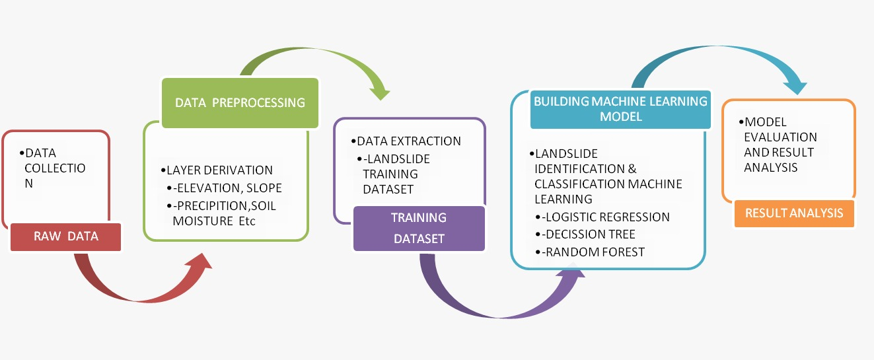
Methodology
  Basic steps in constructing a Machine Learning model:

Slide 11
Data Preparation:
Visualize data to help detect relevant relationships between variables or class imbalances or perform other exploratory analysis
Training the Model:
      The goal of training is to answer a question or make a prediction correctly as often as possible
      Evaluate the Model:
      Test the model against previously unseen data . This unseen data is meant to be somewhat representative of model performance in the real world, but still helps tune the model
Make Predictions:
Using further (test set) data which have, until this point, been withheld from the model are used to test the model a better approximation of how the model will perform in the real world

Slide 12
Result
Confusion matrix:
The confusion matrix is a useful tool for evaluating the performance of a classification model, including in the case of landslide prediction. It provides a summary of the model's predictions and the actual outcomes.
In the context of landslide prediction, the confusion matrix can be constructed as follows:
True Positive (TP): This represents the number of landslide instances that were correctly predicted as landslides by the model.
True Negative (TN): This represents the number of non-landslide instances that were correctly predicted as non-landslides by the model.
False Positive (FP): This represents the number of non-landslide instances that were incorrectly predicted as landslides by the model
False Negative (FN): This represents the number of landslide instances that were incorrectly predicted as non-landslides by the model

Slide 13

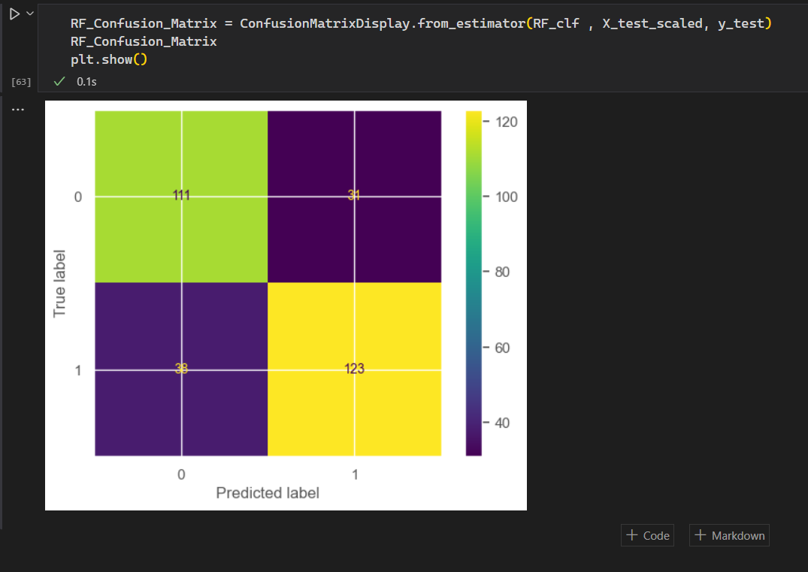
Logistic regression in landslide prediction:
Logistic regression is a commonly used statistical method for binary classification problems, and it can be applied to landslide prediction as well.

Slide 14
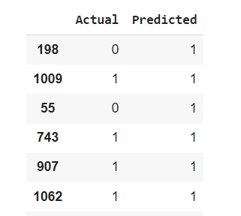
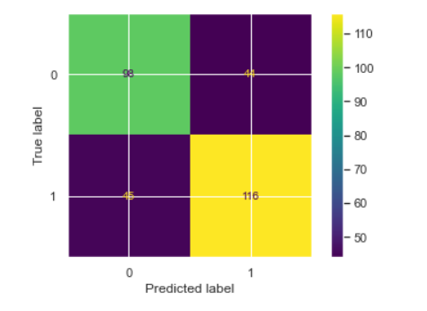
Decision Tree in landslide prediction:
Decision trees can be useful for landslide prediction as they are able to handle both categorical and numerical data, and can capture complex relationships between various input factors and the likelihood of a landslide occurrence.

Slide 15
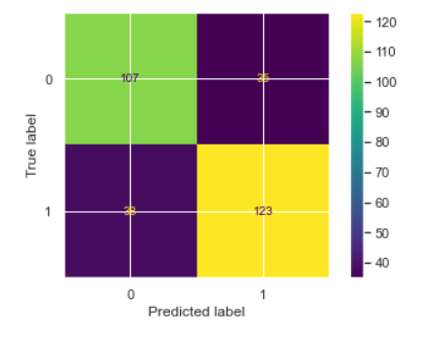
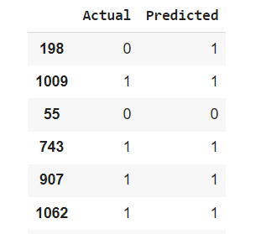
Confusion Matrix for Random Forest:
Random Forest is a popular machine learning algorithm that can be used for landslide prediction. It is an ensemble learning method that combines multiple decision trees to make predictions

Slide 16
Conclusion and Future scope:
In conclusion, landslide prediction is a critical task that requires a combination of data analysis, risk assessment, monitoring technologies, and community engagement.
In our current research 3 popular ML regression and classification models that is Logistic Regression, Decision Tree and Random Forest
Based on the statistical analysis, a ratio of 75/25 for training and testing datasets was considered as the best ratio for training and testing of models.
However, it is important to note that landslide prediction is inherently challenging due to the complex nature of geological processes and the multitude of factors involved.
By investing in research, fostering collaboration, and implementing proactive measures, we can mitigate the risks associated with landslides and strive towards a safer and more resilient future.

Slide 17
References:
[1] A. Wicki, P. Lehmann, C. Hauck, S. I. Seneviratne, P. Waldner, and M. St¨ahli, “Assessing the potential of soil moisture measurements for regional landslide early warning,” Landslides, vol. 17, no. 8, pp. 1881–1896, 2020.
[2] E. C. Johnston, F. V. Davenport, L. Wang, J. K. Caers, S. Muthukrishnan, M. Burke, and N. S. Diffenbaugh, “Quantifying the effect of precipitation on landslide hazard in urbanized and non-urbanized areas,” Geophysical Research Letters, vol. 48, no. 16, p. e2021GL094038, 2021.
[3] M. T. Abraham, N. Satyam, B. Pradhan, and A. M. Alamri, “Forecasting of landslides using rainfall severity and soil wetness: a probabilistic approach for darjeeling himalayas,” Water, vol. 12, no. 3, p. 804, 2020.
[4] S. Martino, M. Fiorucci, G. Marmoni, L. Casaburi, B. Antonielli, and P. Mazzanti, “Increase in landslide activity after a low-magnitude earthquake as inferred from dinsar interferometry,” Scientific reports vol. 12, no. 1, pp. 1–19, 2022.

